Slide 1
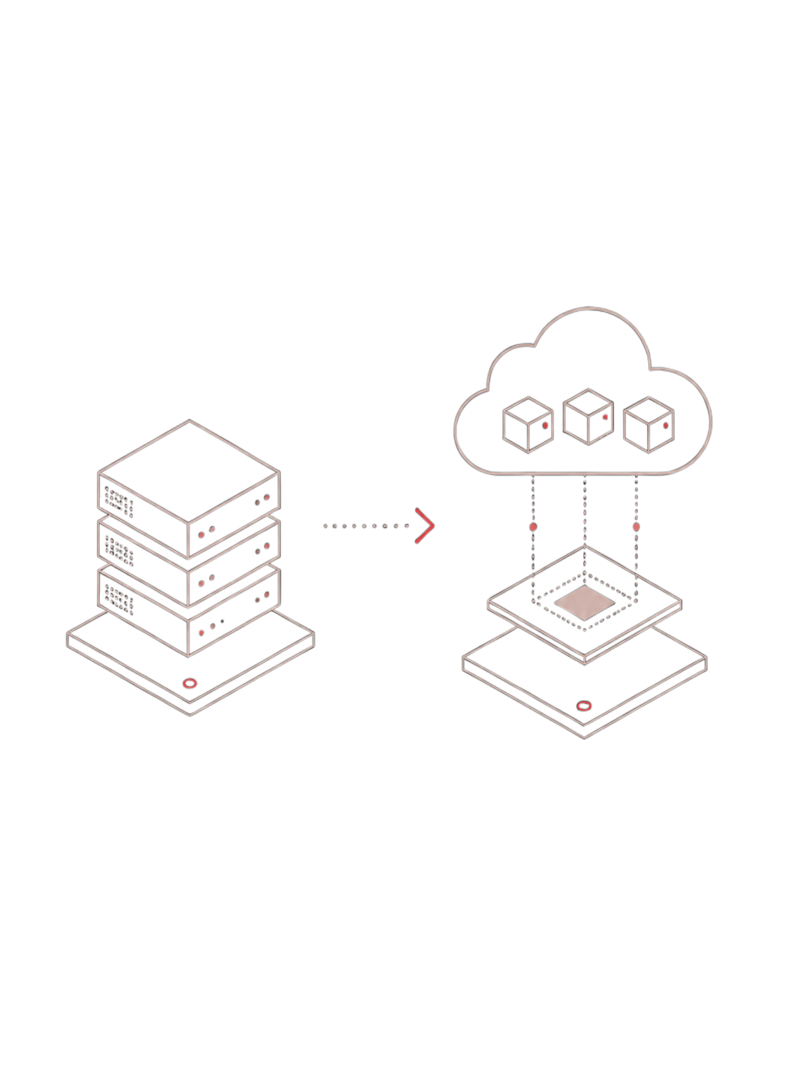
Network Function Virtualization (NFV) and the OSI Architecture
Done By
E Lakshmi Narayanan(192524249)
B tech(AI&DS)

Slide 2
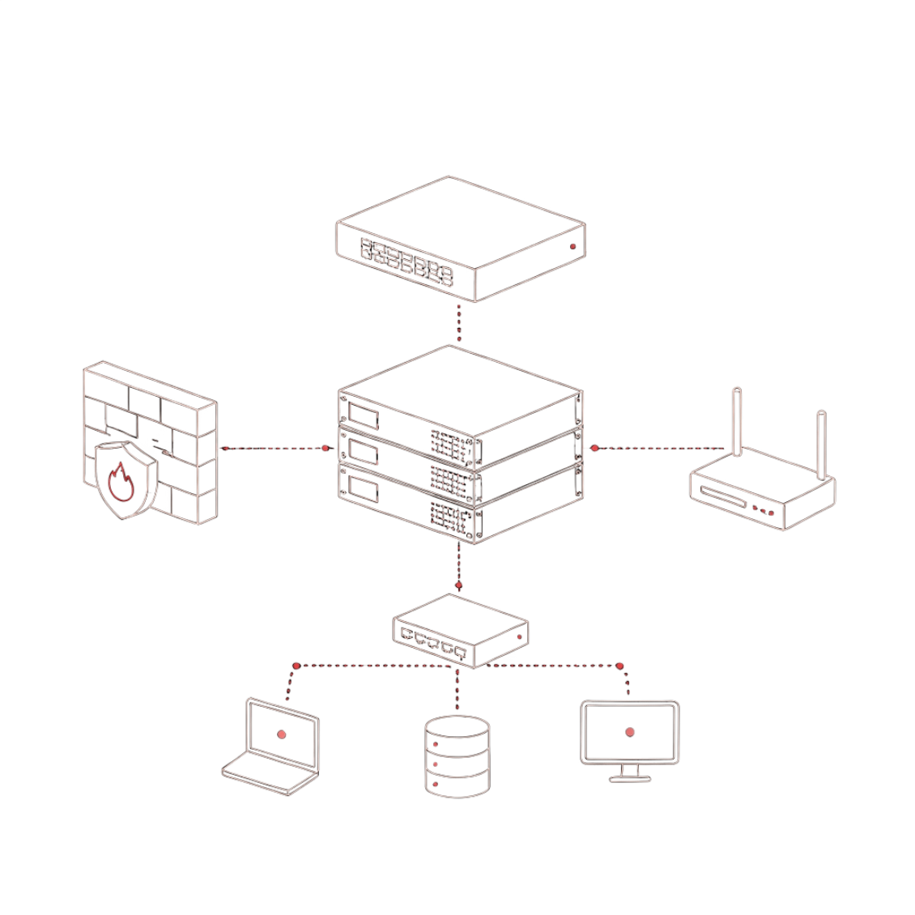
What is Network Function Virtualization (NFV)?
NFV decouples network software from proprietary hardware, enabling network functions to run as software on commodity servers.
Key Benefits
Lower CapEx and OpEx costs
Rapid deployment and scaling — minutes vs. weeks
Flexible resource allocation on demand
Traditional
Virtualized
Hardware-bound boxes — Cisco routers, dedicated firewalls, physical appliances
VNFs running in VMs or Containers on commodity servers

Slide 3
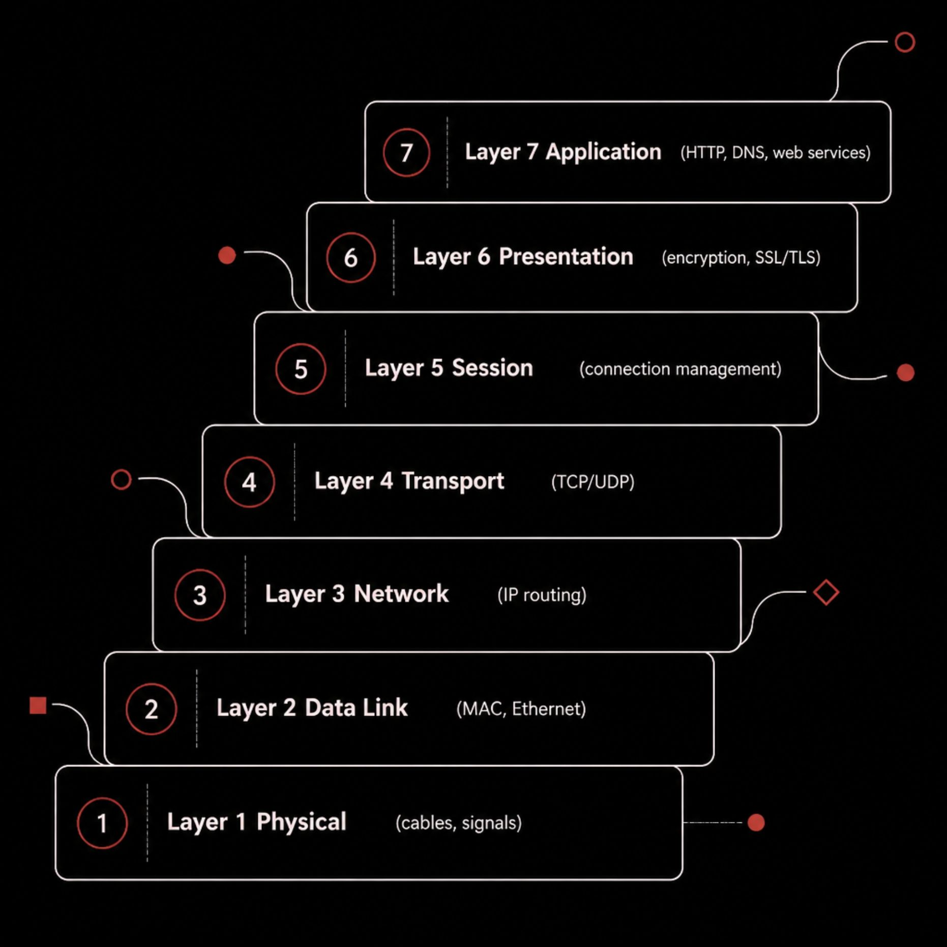
The OSI Reference Model Blueprint
The OSI model provides a universal blueprint for how network communication is structured across seven distinct layers — each with a specific role and set of protocols.
Upper Layers (5–7)
Lower Layers (1–4)
Application, session, and data formatting — where user-facing services live
Transport, routing, switching, and physical transmission — the network fabric

Slide 4
How Virtual Network Functions (VNFs) Span OSI Layers
Every traditional hardware appliance maps to a VNF counterpart — operating at the same OSI layer, but running as software.
Layer
Function
Traditional Appliance
VNF Counterpart
L7
Application
Load Balancers, WAF
Virtual WAF, API Gateways
L4–5
Transport / Session
Firewalls, NAT
vFW, vNAT
L3
Network
Routers
vRouter, IPsec VPNs
L2
Data Link
Physical Switches
vSwitch, Open vSwitch
L1
Physical
Network Interface Cards (NICs), cables, transceivers
Virtual NICs (vNICs), virtual network interfaces

Slide 5
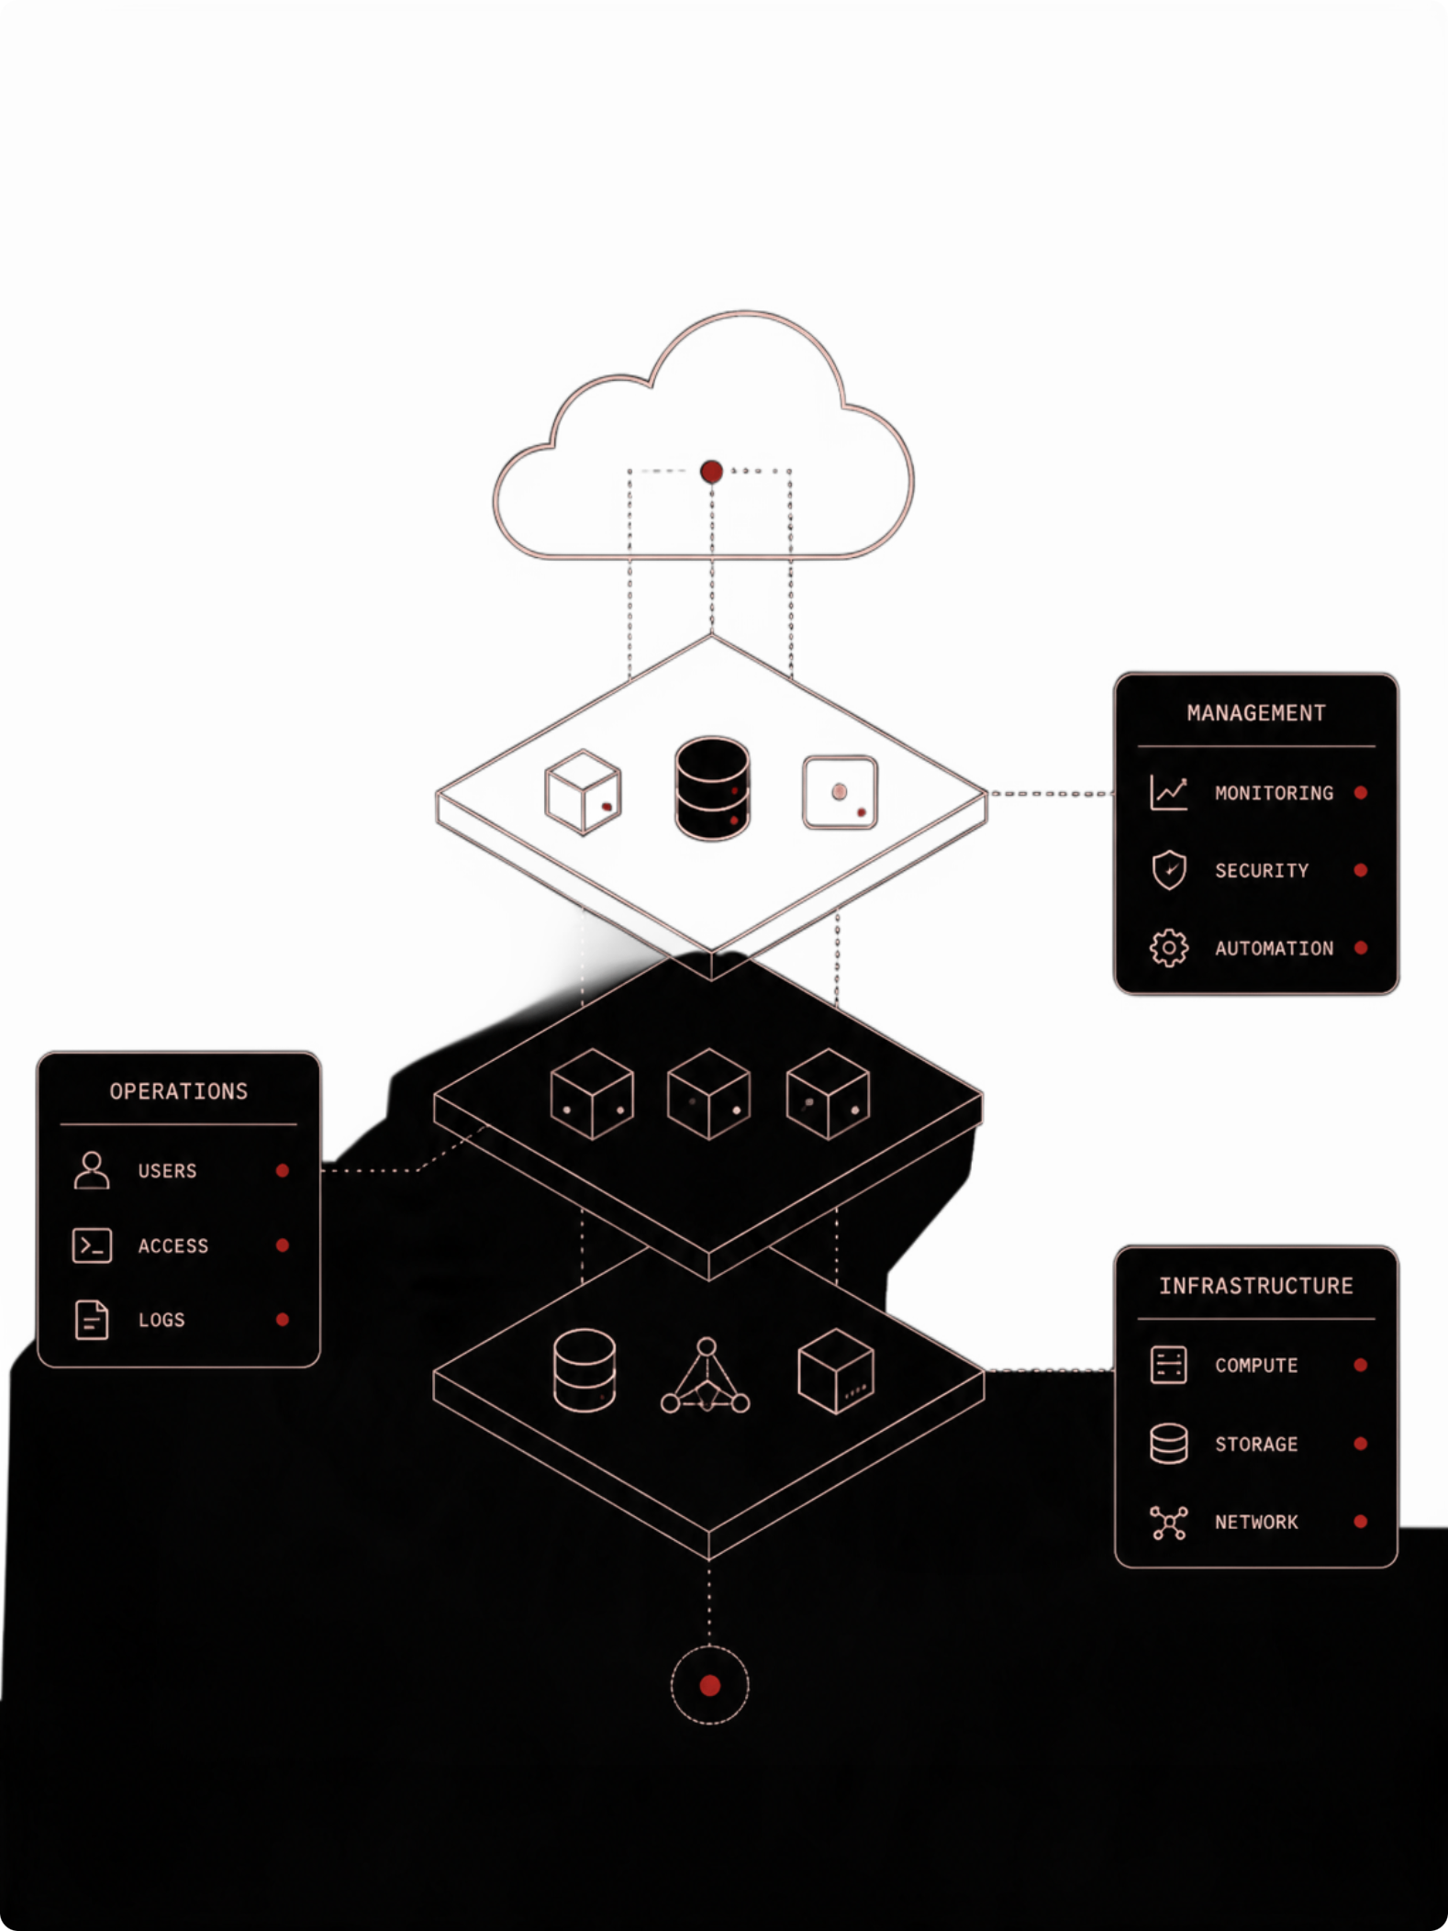
NFV Architectural Framework
VNFs
NFV
Operate at Layers 2–7 depending on function — firewalls, routers, load balancers, all virtualized
Infrastructure layer — compute, storage, and networking hardware abstracted by a hypervisor
MANO
Management & Orchestration — governs lifecycle, deployment, and scaling across all layers

Slide 6
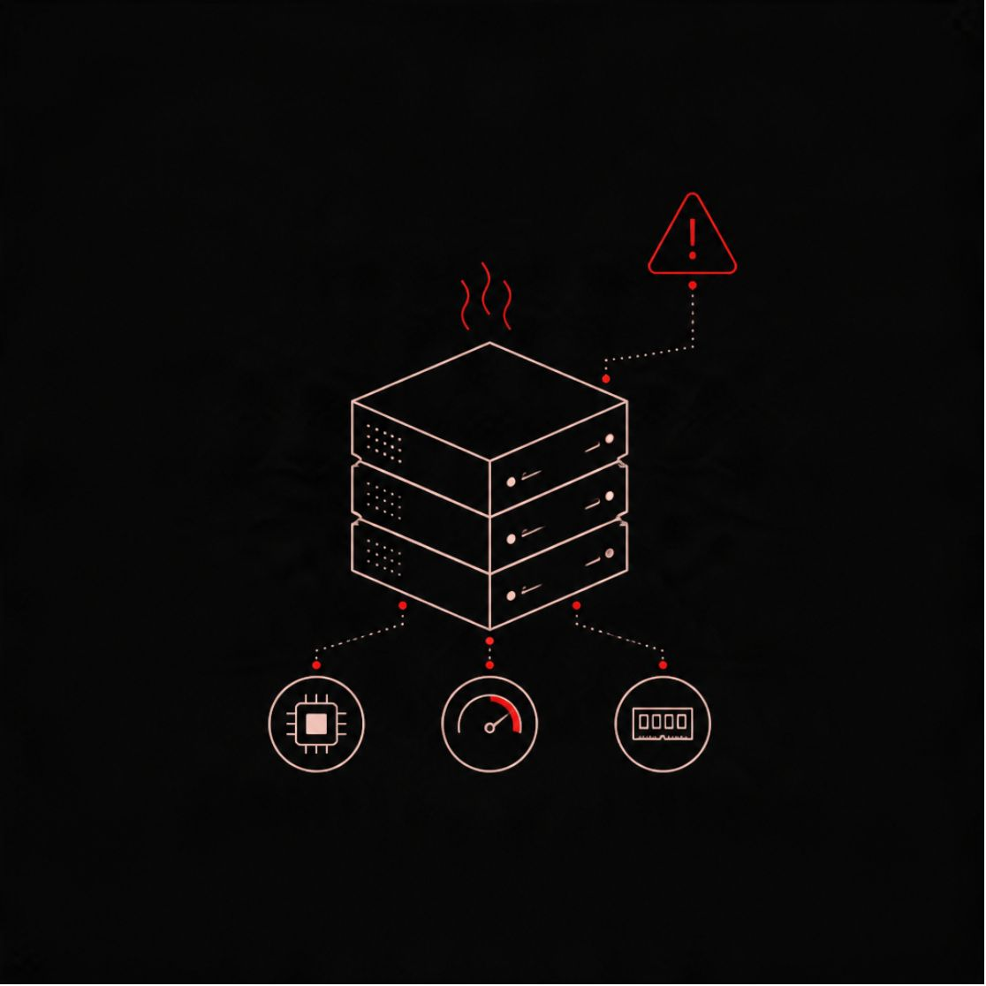

Implementation Challenges in Virtualizing OSI Layers
1
2
3
Performance & Latency
Virtual Switching Overheads
Security & Isolation
x86 software is slower than hardware ASICs. Mitigated with DPDK and SR-IOV acceleration techniques.
Multi-tenancy risks — a hypervisor compromise can threaten all virtualized layers simultaneously.
Inter-VM packet routing drives high CPU utilization, creating bottlenecks at scale.

Slide 7
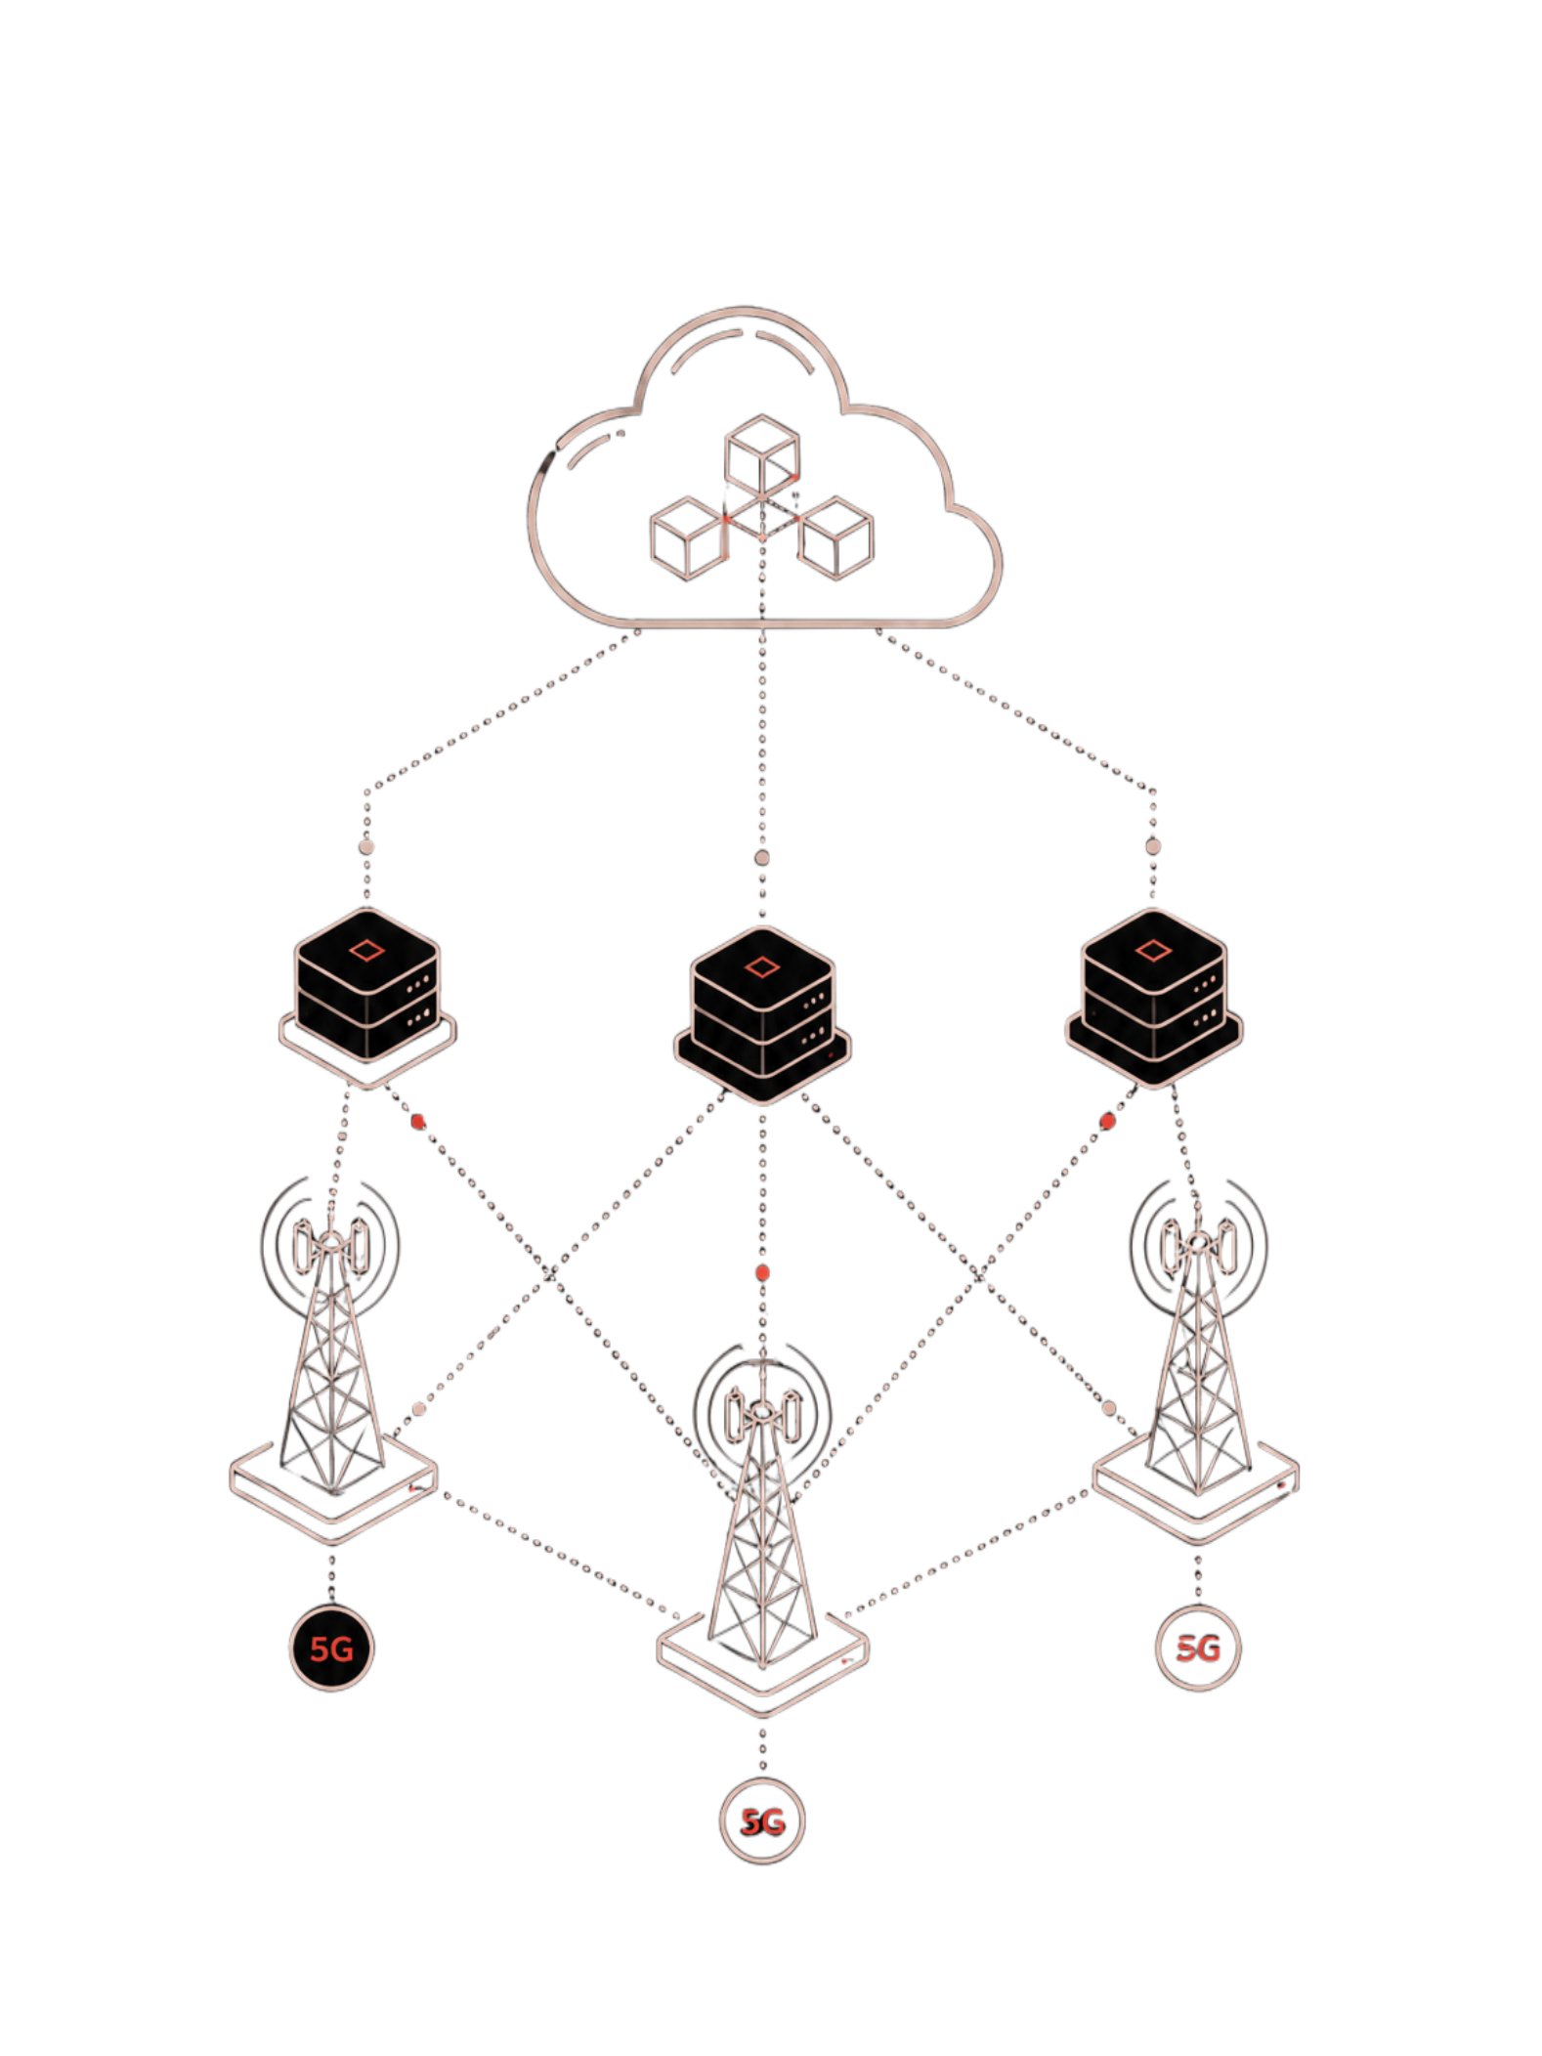

Summary & Future Outlook
Paradigm Shift
Hardware boxes give way to flexible software services spanning the full OSI stack — agile, scalable, and cost-efficient.
Key Insight
NFV changes where and how layer functions execute — not what they do. The OSI model remains the constant foundation.
Future Horizon
NFV + SDN + cloud-native microservices converge to power 5G/6G networks and distributed edge computing at global scale.

